Slide 1

Basic Details of the Team and Problem Statement
Ministry/Organization Name/Student Innovation: Ministry Of Railways
PS Code: 1349
Problem Statement Title: Using existing CCTV network for crowd management, crime prevention, and work monitoring using AIML
Team Name: Code Crusaders
Team Leader Name: Raja Parisha Viralbhai
Institute Code (AISHE): U-0136
Institute Name: Gujarat University
Theme Name: Smart Automation

Slide 2
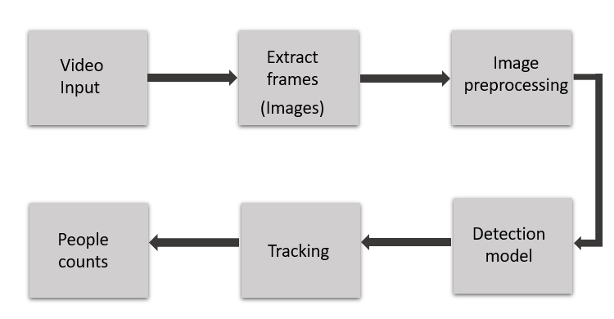
Idea/Approach Details
Flow chart
Idea/Solution/Prototype:
AI-Powered Crowd Analysis: Implement advanced AI and ML algorithms to analyze real-time video feeds from the existing CCTV network across Indian Railways.
Pattern Detection and Prediction: Utilize these algorithms to detect and predict crowd patterns, providing authorities with timely insights into potential congestion points.
Proactive Measures: Empower authorities to take proactive steps to prevent overcrowding, ensuring passenger safety and a more efficient railway operation.
Optimized Resource Allocation: By leveraging this technology, authorities can allocate resources strategically to manage crowds effectively, especially during peak hours or special events.
Technology stack :
AI/ML frameworks: PyTorch
Video Processing libraries: OpenCV
Object Detection Models: yolov8
Object Tracking: Deepshort Algorithm
Web development framework: Django and Flask
Database: MySQL

Slide 3
Idea/Approach Details
Use Cases
Dependencies / Showstopper
Peak Hour Management: Effectively handle high passenger volumes during peak travel times, ensuring smooth flow and minimizing congestion.
Event Crowd Control: Manage large gatherings for events or festivals by anticipating crowd movements and implementing necessary precautions.
Emergency Response: Quickly identify and respond to emergency situations, ensuring passenger safety and timely assistance.
Station Capacity Planning: Optimize platform and station capacities based on real-time crowd data, improving overall operational efficiency.
Dependencies:
Availability of High-Quality CCTV Footage
Adequate computing power
Reliable network connectivity
Integration with Railway Infrastructure
Showstoppers:
Privacy concerns
Data Security
Technical Challenges
Bias in AI/ML models
Lack of expertise

Slide 4
Team Member Details
Team Leader Name: Raja Parisha Viralbhai
Branch : Integrated MSc. Stream : Data Science Year : IV
Team Member 1 Name: Patel Jimil Mitesh
Branch : Integrated MSc. Stream : Data Science Year : IV
Team Member 2 Name: Solanki Prachi Piyushbhai
Branch : Integrated MSc. Stream : Data Science Year : IV
Team Member 3 Name: Patel Shreni Pranav
Branch : Integrated MSc. Stream : Data Science Year : IV
Team Member 4 Name: Patel Urva Nalinkumar
Branch : Integrated MSc. Stream : Data Science Year : IV
Team Member 5 Name: Valand Ronak Kalpeshbhai
Branch : Integrated MSc. Stream : Data Science Year : IV
Team Mentor 1 Name: Asit Pandit
Category : Industry Expertise : AIML Domain Experience (in years): 5+

